Slide 1

Hive
Big Data

Slide 2
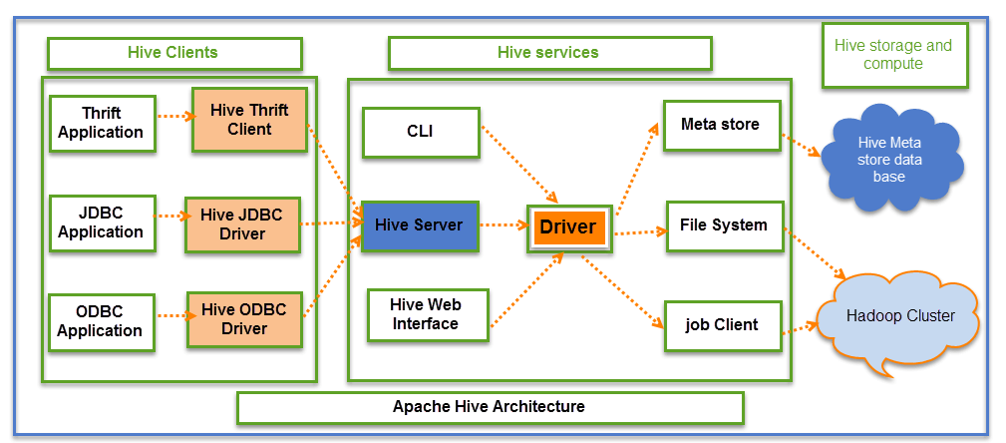
What is Hive?
Hive is an ETL and Data warehousing tool developed on top of Hadoop Distributed File System (HDFS). Hive makes job easy for performing operations like
Data encapsulation
Ad-hoc queries
Analysis of huge datasets
Hive Consists of Mainly 3 core parts
Hive Clients
Hive Services
Hive Storage and Computing

Slide 3
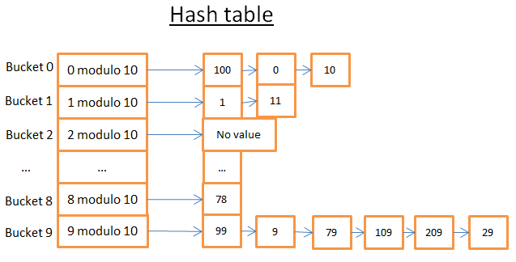
Hive – Data Model
Database
Database is in hive a namespace where particular table resides.
Tables
Database and schema in namespace
Partitions
How data store in HDFS
Grouping data bases on column reference
Can have one or more column
Buckets & Clusters
Partition divided on bucket bases or some other column reference using hash function
Use for data sampling

Slide 4
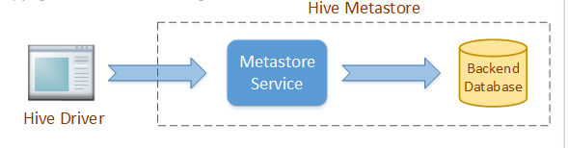
Hive - Metastore
All Hive implementations need a Metastore service, where it stores metadata.
By default, Hive uses a built-in Derby SQL server. It provides single process storage, so when we use Derby, we cannot run instances of Hive CLI.
Whenever we want to run Hive on a personal machine or for some developer task, then it is good, but when we want to use it in a cluster, then MySQL or any other similar relational database is required.
Default Directory of Hive Metastore is : HDFS:///user/hive/warehouse
Ref : https://dzone.com/articles/hive-metastore-a-basic-introduction

Slide 5
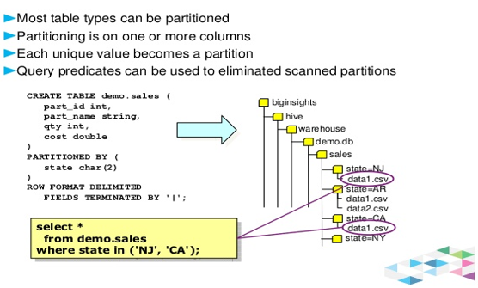
Hive – Partition
Its Show how partitioning save file in hive warehouse directory

Slide 6
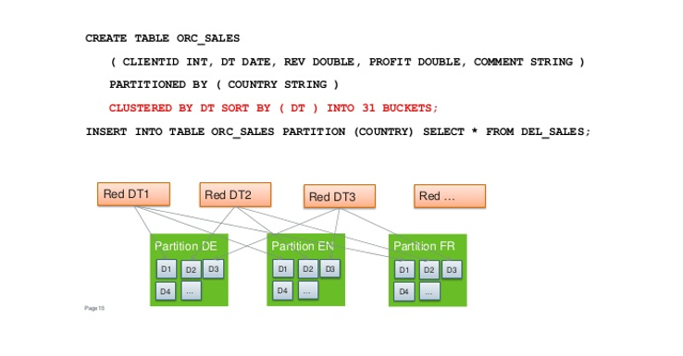
Hive – Buckets

Slide 7
Hive – Partition vs Buckets (Detail)
Bucketing – In Hive Tables or partition are subdivided into buckets based on the hash function of a column in the table to give extra structure to the data that may be used for more efficient queries.
Partitioning – Apache Hive organizes tables into partitions for grouping same type of data together based on a column or partition key. Each table in the hive can have one or more partition keys to identify a particular partition. Using partition we can make it faster to do queries on slices of the data.
Pros:
It distributes execution load horizontally.
In partition faster execution of queries with the low volume of data takes place. For example, search population from Vatican City returns very fast instead of searching entire world population.
Cons:
There is the possibility of too many small partition creations- too many directories.
Partition is effective for low volume data. But there some queries like group by on high volume of data take a long time to execute. For example, grouping population of China will take a long time as compared to a grouping of the population in Vatican City.
There is no need for searching entire table column for a single record.
Pros:
It provides faster query response like portioning.
In bucketing due to equal volumes of data in each partition, joins at Map side will be quicker.
Cons:
We can define a number of buckets during table creation. But loading of an equal volume of data has to be done manually by programmers.

Slide 8
Different modes of Hive
These modes are,
Local mode
Map reduce mode
When to use Local mode:
If the Hadoop installed under pseudo mode with having one data node we use Hive in this mode
Data size is smaller.
When to use Map reduce mode:
If Hadoop is having multiple data nodes and data is distributed across different node we use Hive in this mode
It will perform on large amount of data sets and query going to execute in parallel way

Slide 9
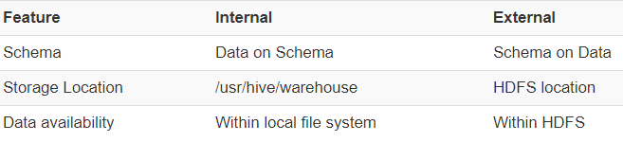
Table types and its Usage:
Hive deals with two types of table structures depending on the loading and design of schema.
Internal
If the processing data available in local file system.
If we want Hive to manage the complete lifecycle of data including the deletion.
External
If processing data available in HDFS.
Useful when the files are being used outside of Hive.

Slide 10
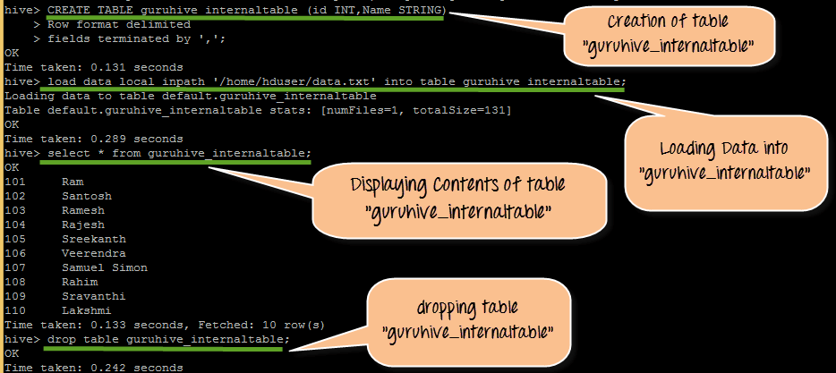
Hive - Internal Table

Slide 11
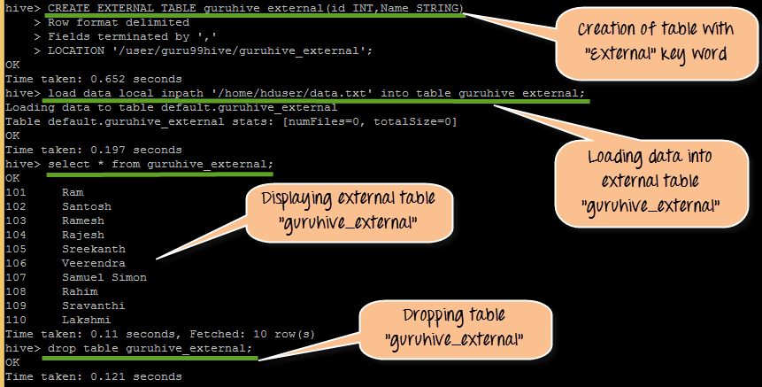
Hive – External Table

Slide 12
References:
https://www.edureka.co/blog/hive-commands-with-examples
https://www.youtube.com/watch?v=rb388Oya9nY - (Buckets)
https://www.youtube.com/watch?v=MmJu0GzyNE4 - (Buckets vs Partition)
https://www.youtube.com/watch?v=L-lDCYuNQfE - (Buckets vs Partition)
https://www.youtube.com/watch?v=010HXgJ0hJs - (Bucket Creation)
https://www.guru99.com/introduction-hive.html - (Overall Hive Concepts)

